Slide 1

EDUTECH MANAGEMENT SYSTEM
TEAM : F
Team Members:
Neethu Resmi (Scrum Master)
Mubeena M S
Jesfar S
Alan P Nath
Ann Mary Binu

Slide 2
AGENDA
Introduction
Problem Statement
Requirements
Modules
Functional Requirements
Solutions
Non-Functional Requirements
Flow Chart
Presentation Title

Slide 3

INTRODUCTION OF NEXUS UNIVERSITY
Mission: Academic excellence, Innovation and Global impact, Continuous improvement and strategic expansion
Educational Approach: Uses cutting-edge technologies for students.
Focus Areas: Intellectual curiosity, Leadership Skills, Empowers student success
Global Recognition: Committed to empowering future generation of leaders and innovators
Core values: Integrity ,Excellence, Inclusivity

Slide 4


Lack of centralized software solution hampers productivity in administrative, academic and student service operations
Results in disjointed service and inefficient data management
Difficulty in terms of managing student information, teacher administration and class/curriculum overview.
PROBLEM STATEMENT
EduTec Management System

Slide 5
SOLUTION
Implement a centralized student information management Module to store and retrieve data efficiently, Leveraging SQL server for robust database management.
Introduce a module for class, allowing administrators to manage class schedules, allocate resources, and update curricula dynamically.
Incorporate real-time analytics and reporting features to empower administrators with insights for informed decision-making.
Accessible to students through the user-friendly interface, providing insights into grades, attendance, and overall performance.

Slide 6

FUNCTIONAL REQUIREMENTS
Authentication Module
User Registration Form
Login Form
Password Recovery Mechanism
Student Management Module
CRUD Operations
View Details for students
Report Generation Mechanism
Teacher Management Module
CRUD Operations
Assignment Mechanism for Classes
View Details for teachers
Class Management Module
Schedule Classes
View Details for individual classes
Attendance Tracking Module
Record Attendance for students and teachers
Generate Reports for attendance analysis
Examination Module
Schedule Exams for specific classes
Record Results and publish them
Communication Module
Send Notifications to relevant parties
Announcements

Slide 7
NON-FUNCTIONAL REQUIREMENTS
Security:In this system, user authentication will be done by login by username and password and classified by user type.
Performance: Easy tracking of records and updation can be done.
User Friendly: The System is very Interactive

Slide 8
FEATURES
Password Recovery: Mobile Number Verification, Email Verification, Captcha.
Login: Remember User Credentials, Forgot Password, Password Change in a period.
Feedback Portals: Student and Teachers.
Graphical representation based on Student performance.
Leader Board based on student's performance.

Slide 9
Technologies Used
Back-end technologies
Asp.Net Core
SQL server
Entity Framework
Front-end technologies
React vite.js
HTML
CSS
JavaScript

Slide 10
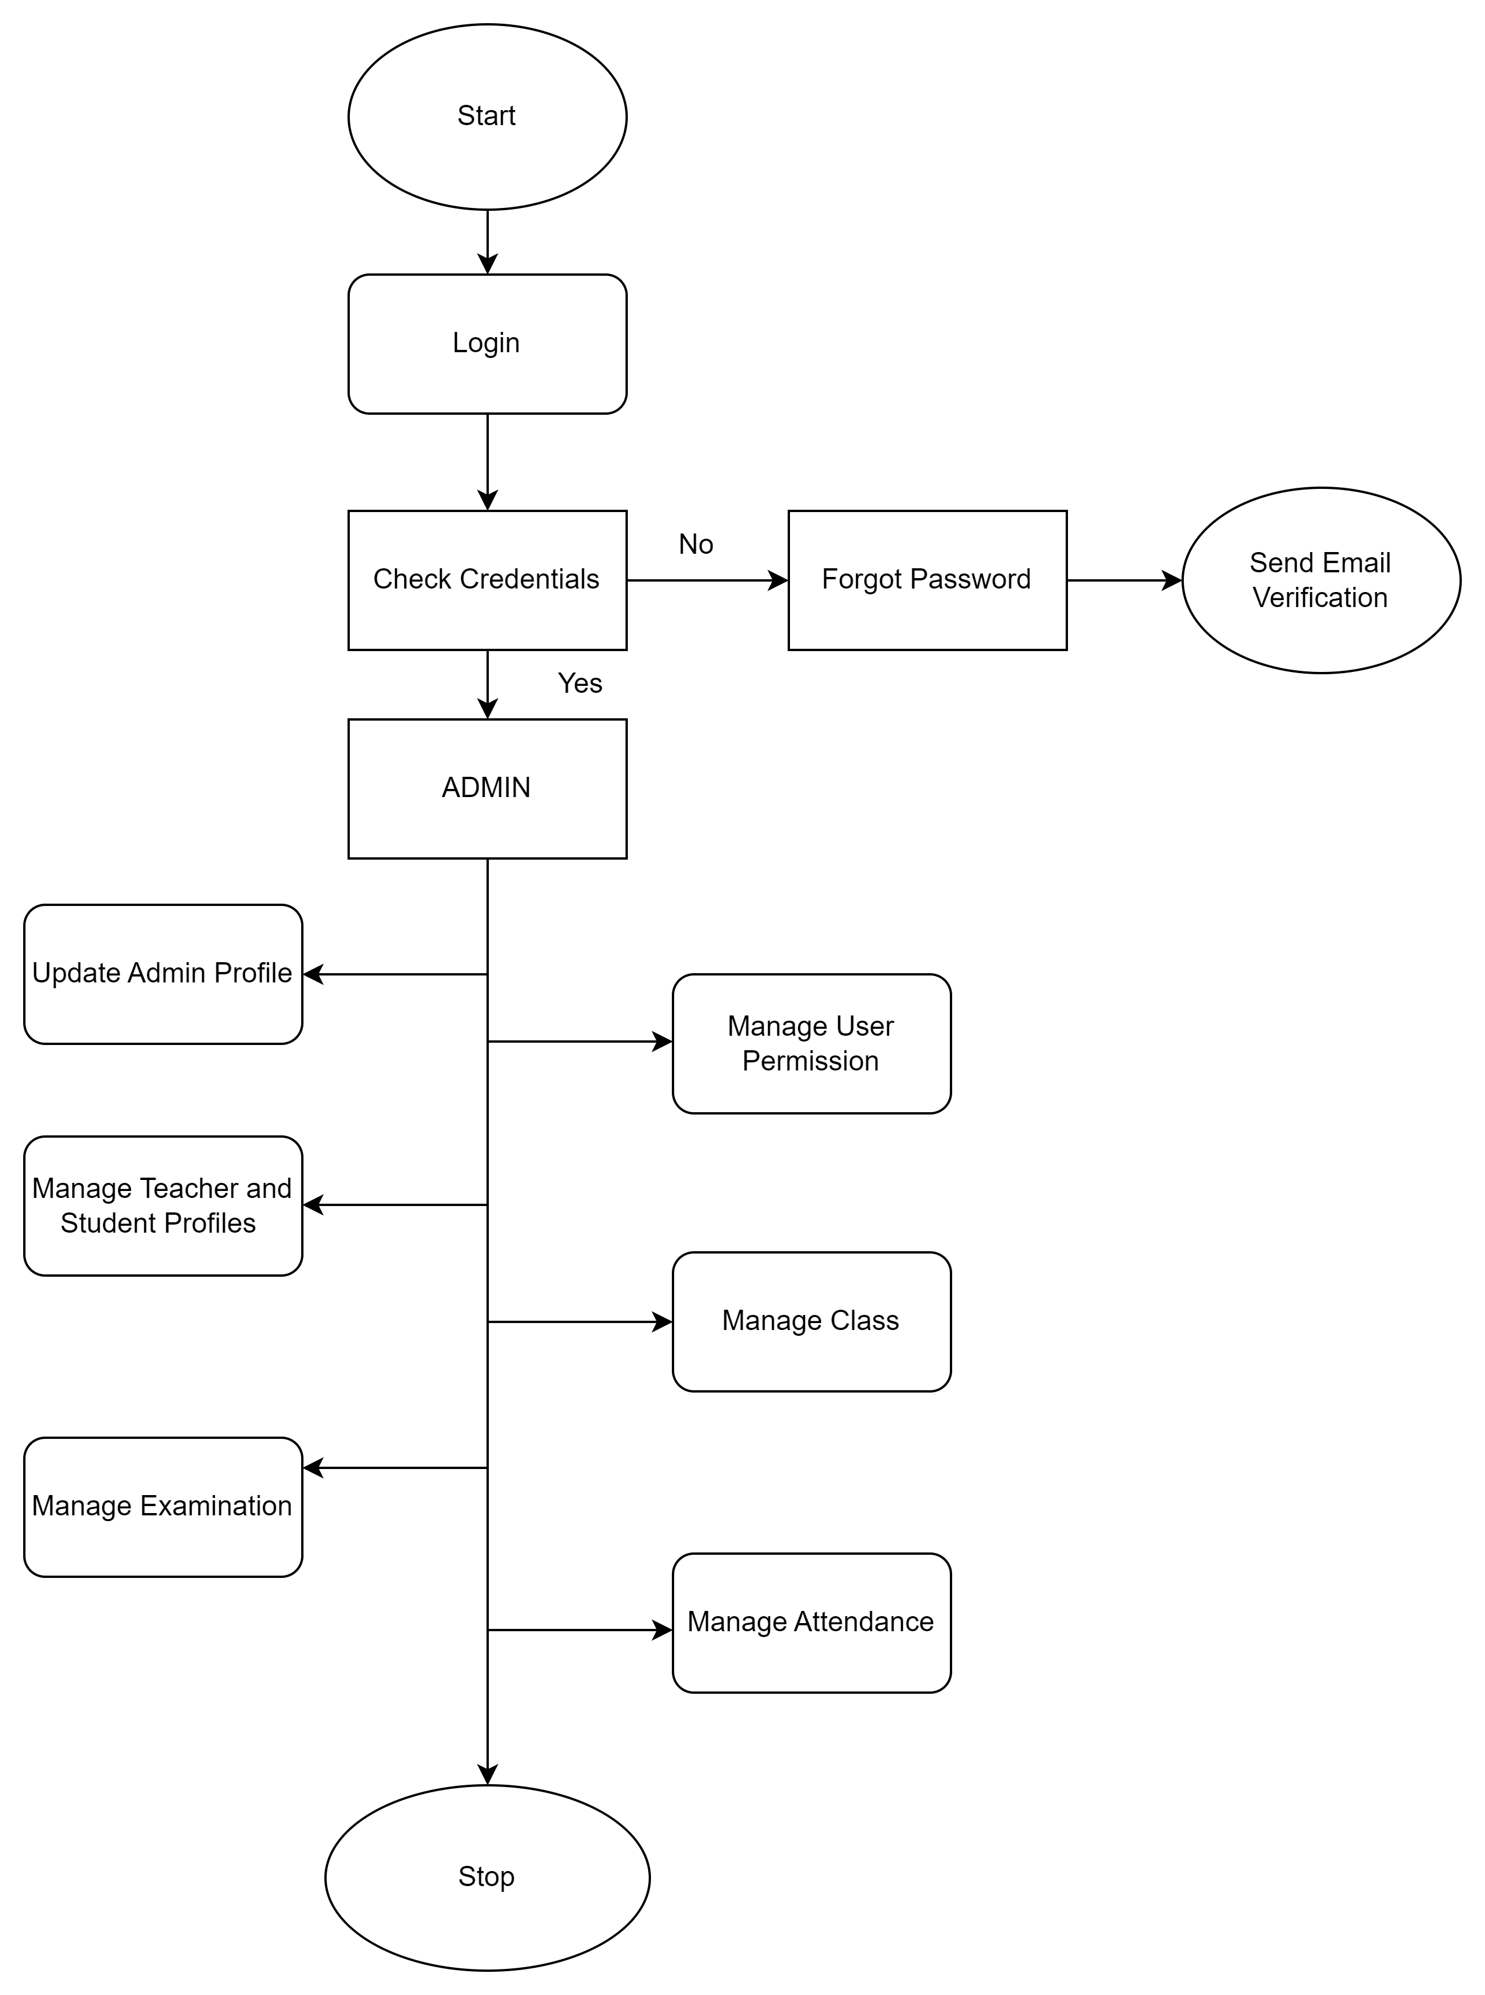
ADMIN FLOW CHART

Slide 11
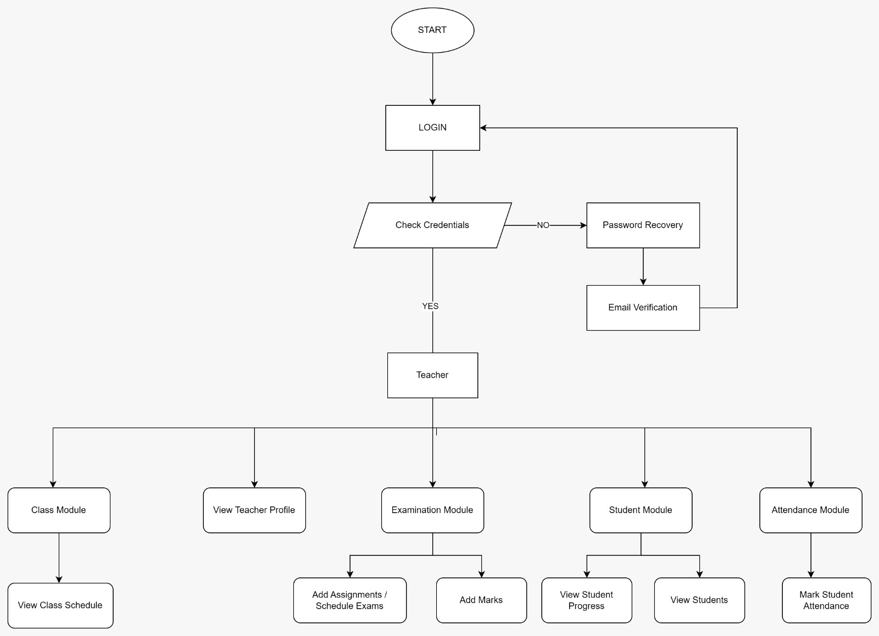
TEACHER FLOW CHART

Slide 12
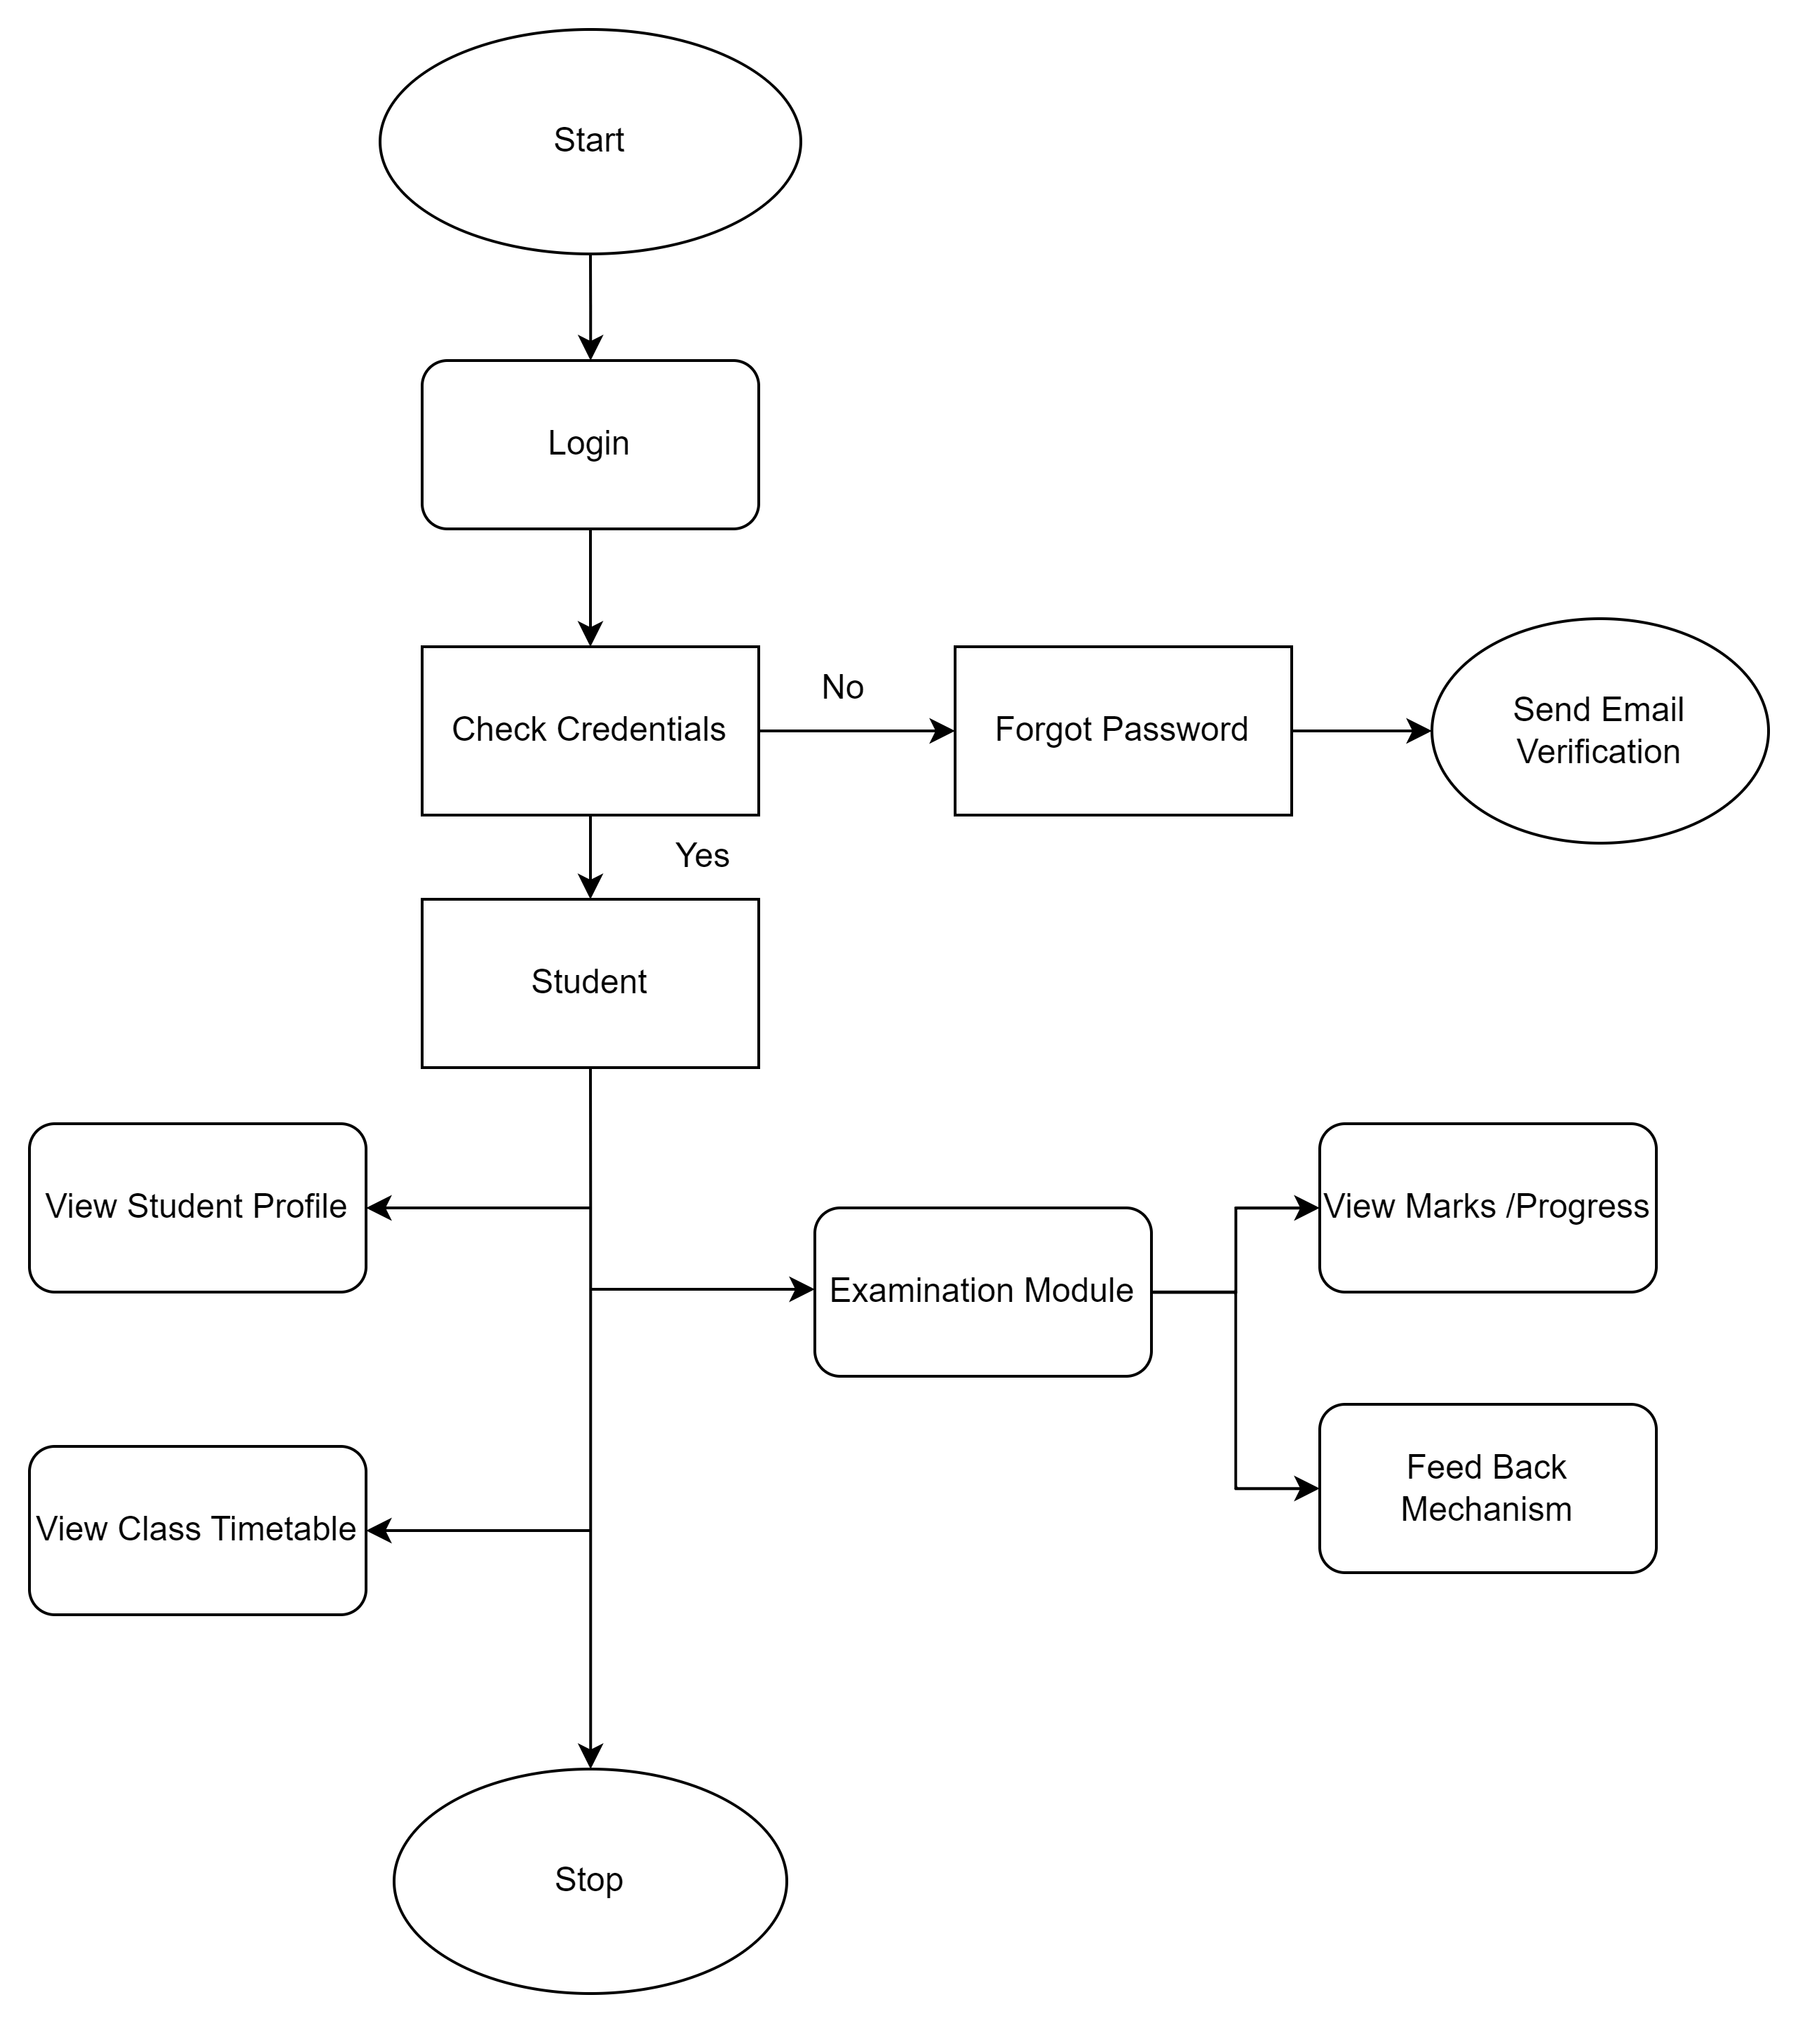
STUDENT FLOW CHART

Slide 13




THANK YOU

